Slide 1
A H O J H E L L O from Campbell Town District High School

Slide 2
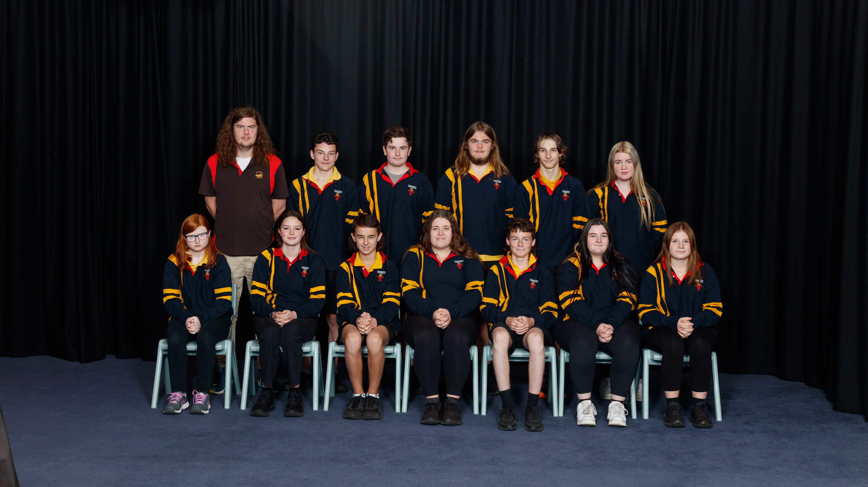

Slide 3
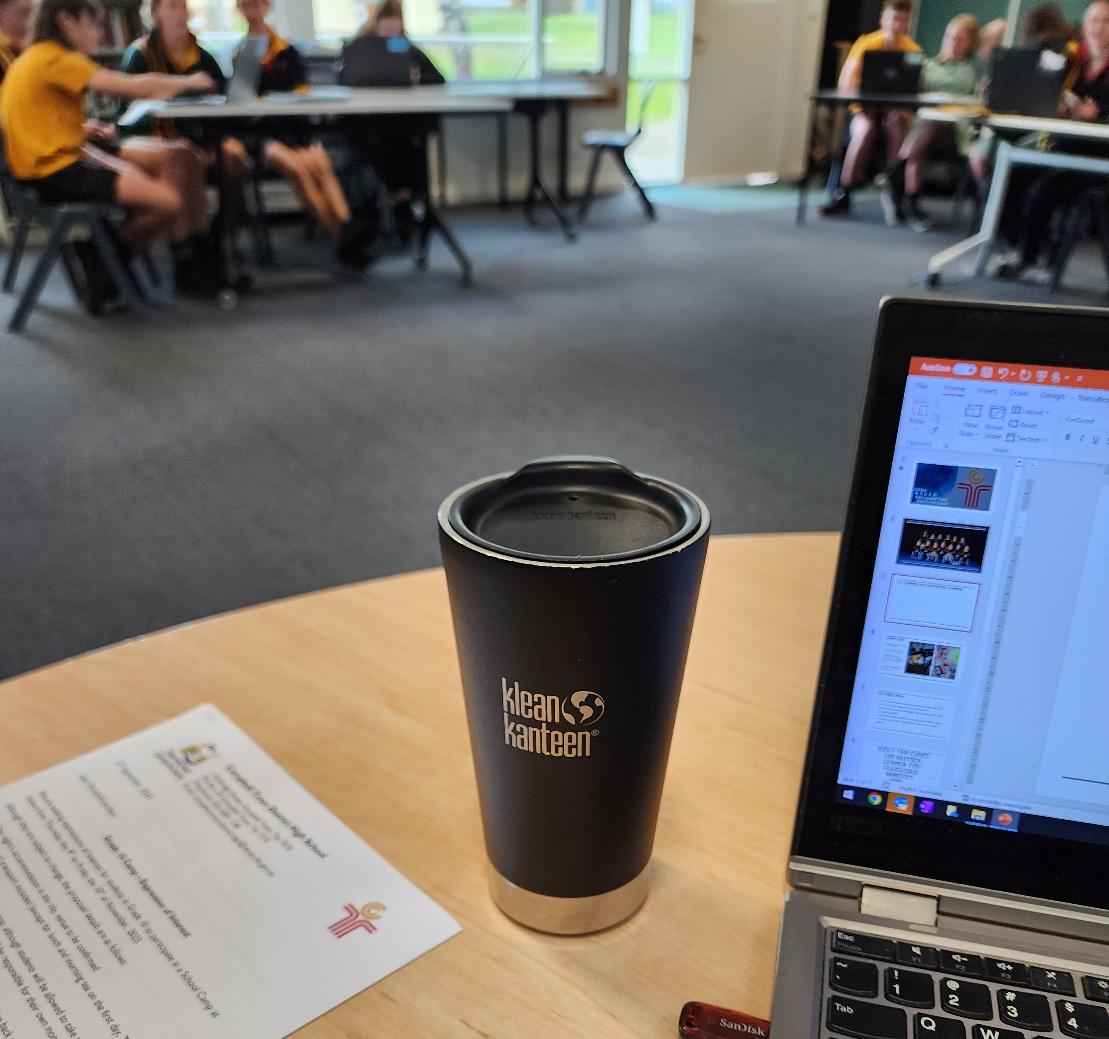
My School Day revolves around…
…My coffee cup!
7:20am – Wake up
7:25am – Coffee
7:35am – Shower and get dressed
7:45am – Coffee
8:10am – Arrive at school
8:15am – Coffee
8:20am – Get all my resources and materials ready
8:50 to 3:00pm – Lessons and coffee
3:20 to 4:30pm – Meetings and one last coffee!

Slide 4
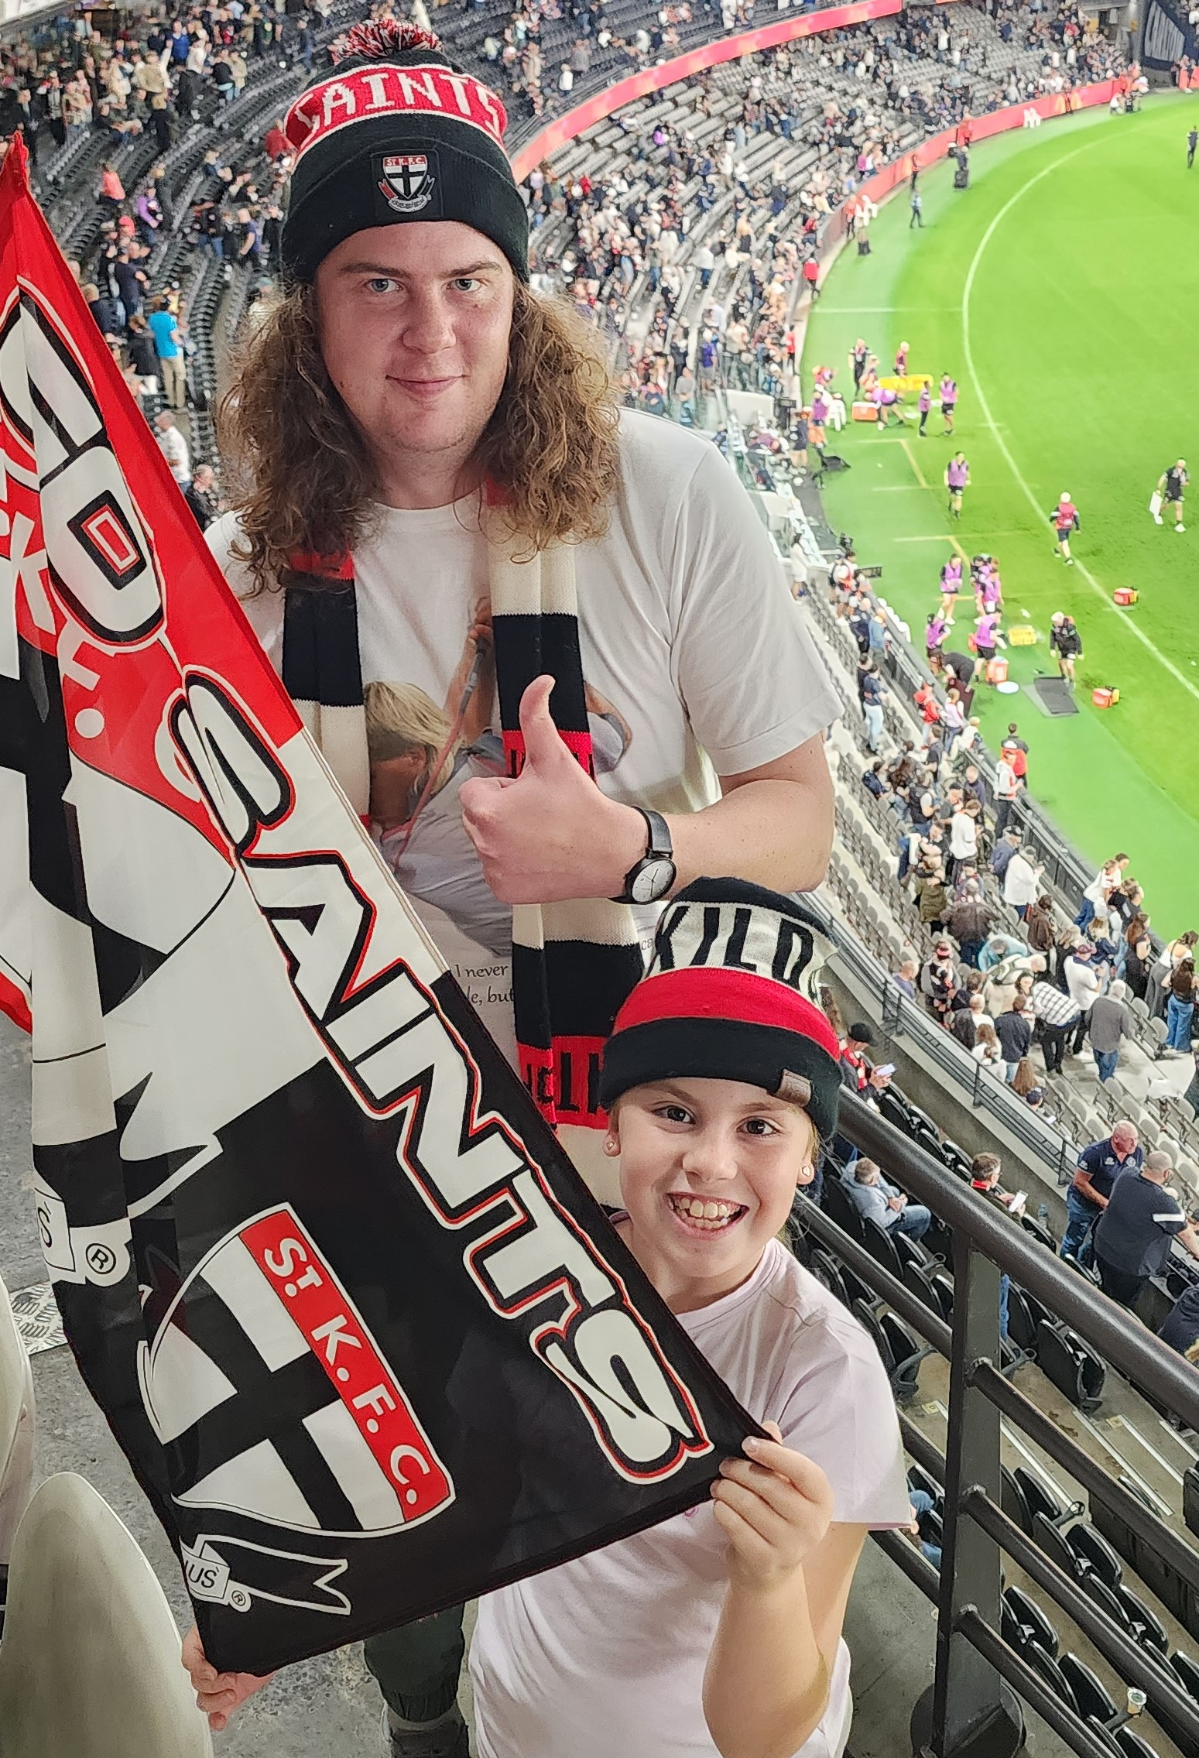
About ME
Moje jmeno je Tom Hodge and
I am 35 years old.
I have been a teacher for 7
years now and I love my job.
I enjoy playing sports like
cricket and soccer, drawing,
gaming on my computer, and
socialising with my friends and
family.
I have a dog named Mila that is
crazier than I am! (She would
probably disagree…)

Slide 5
My Questions
When I visit the Czech Republic, where should I go and what should I do?
What are your first thoughts when you think of Australia?
If you had to recommend one Czech food to the world what would it be and why? (recipe, please ☺)
Was Petr Čech a better goalkeeper than David Seaman or Peter Schmeichel?
What holidays and festivals are celebrated during the year in the Czech Republic?

Slide 6
What you might see driving
around the Tasmanian country
side…

Slide 7
Sheep and Hills

Slide 8
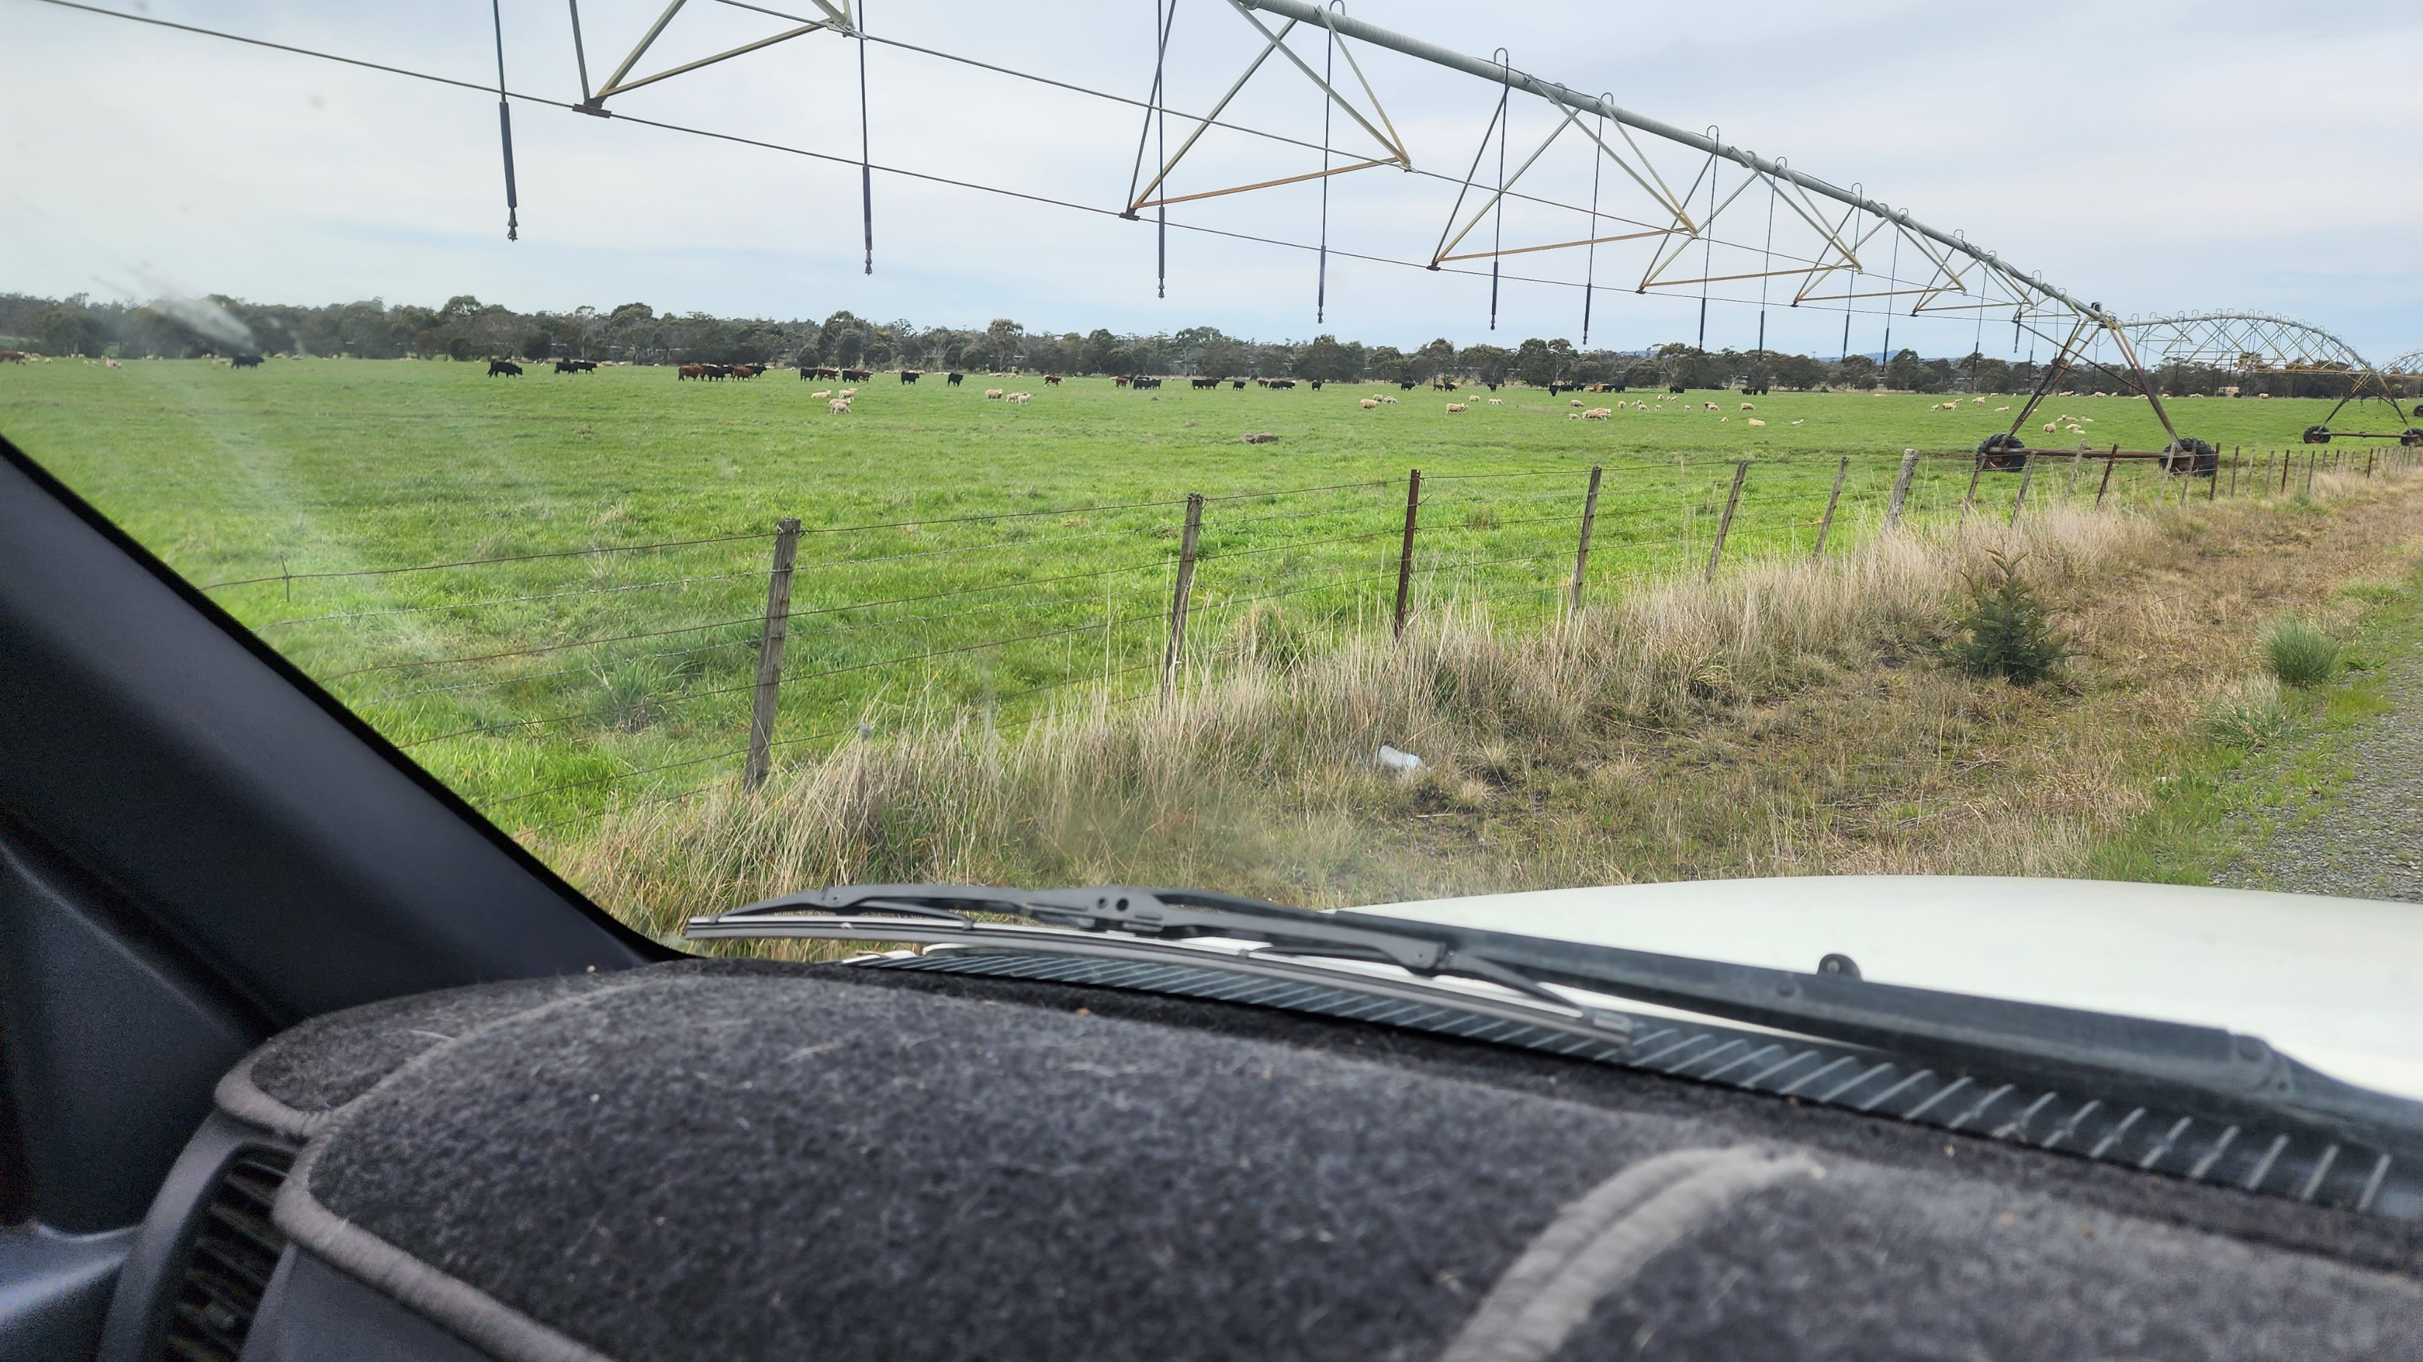
Sheep and cows
(and pivot irrigators)

Slide 9
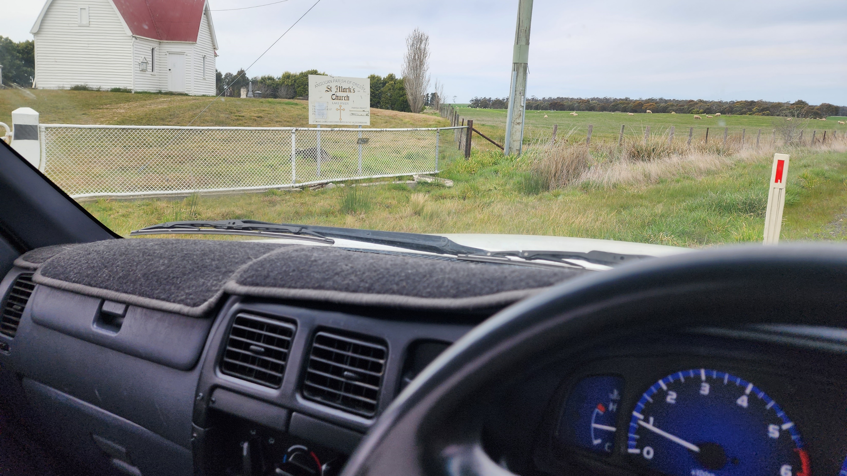
Sheep and Churches
(that are in the middle of nowhere for some
reason)

Slide 10
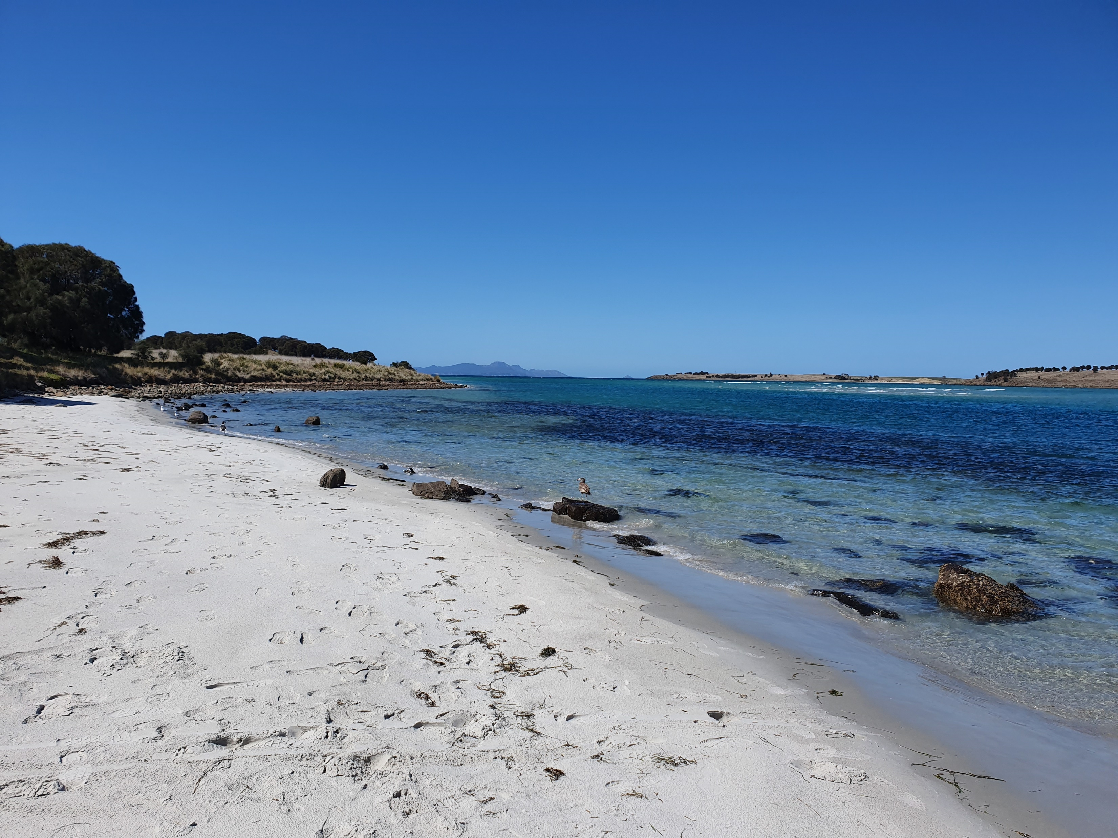
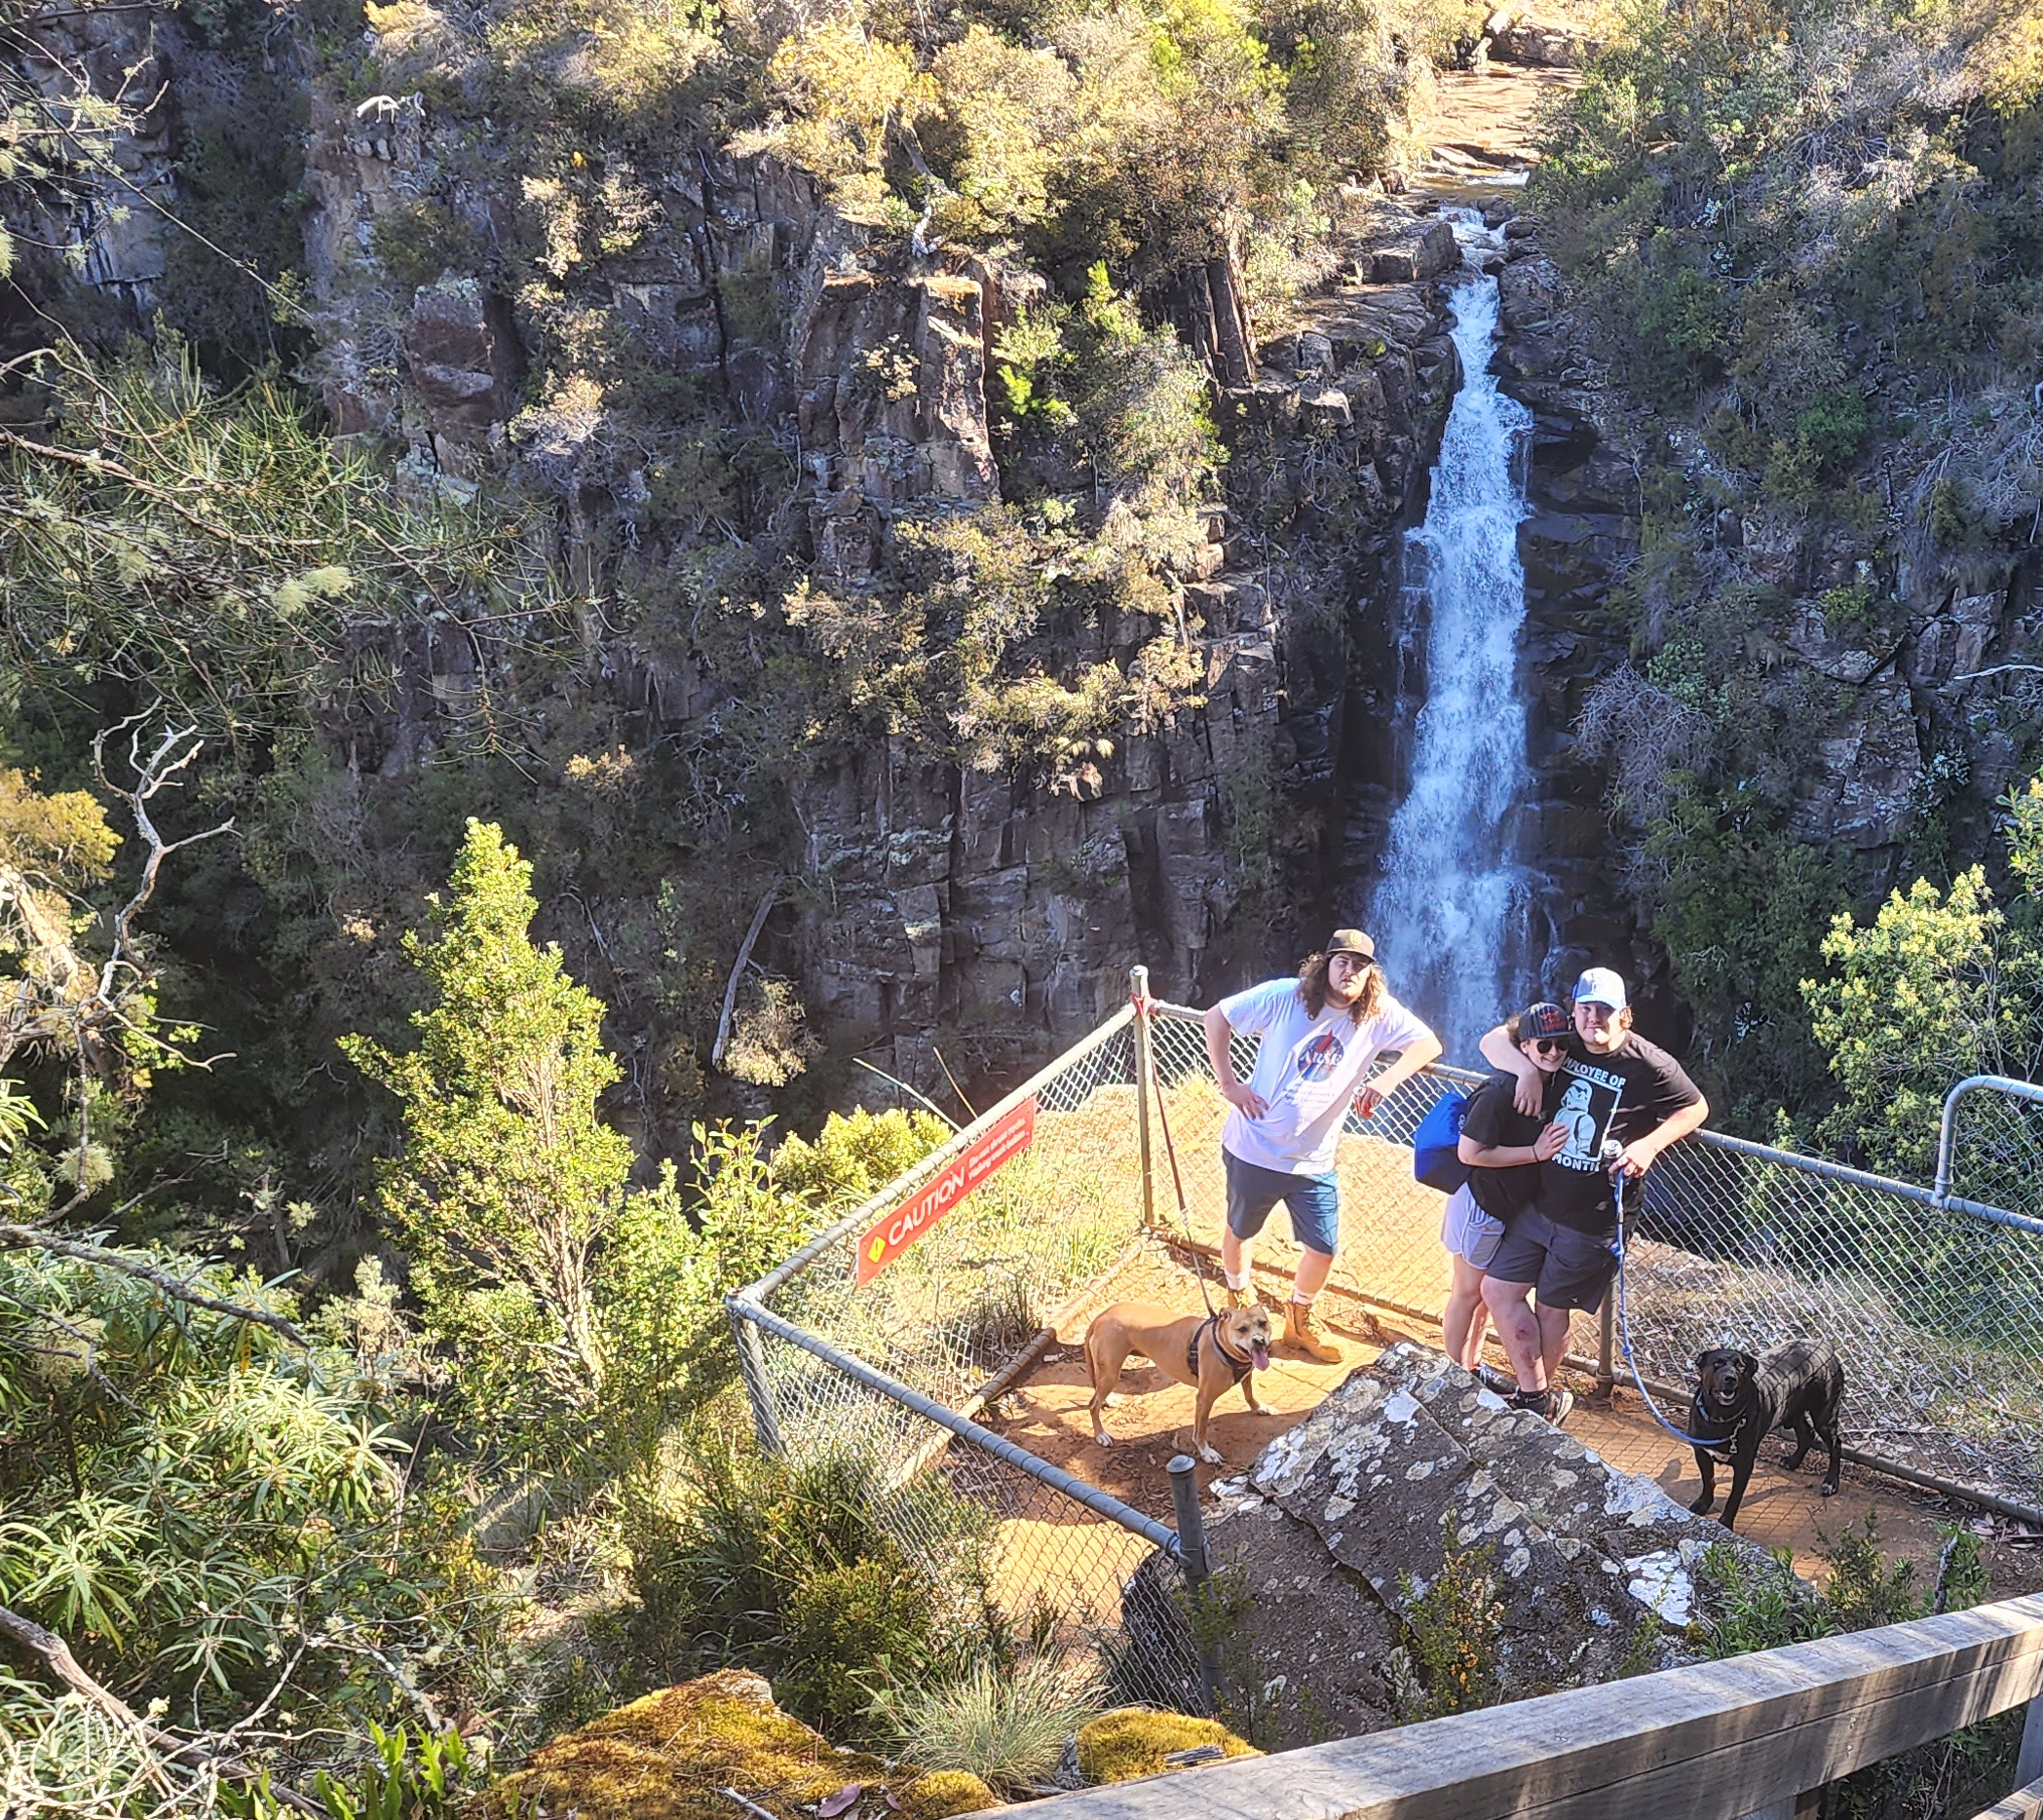
There’s a reason why: Tasmania has a population of 500,000 or so people but has
approximately 2.5 million sheep!
It’s not all sheep though. Campbell Town is only a bit over an hour’s drive from
beautiful beaches, picturesque waterfalls, and to Launceston, the closest city.

Slide 11
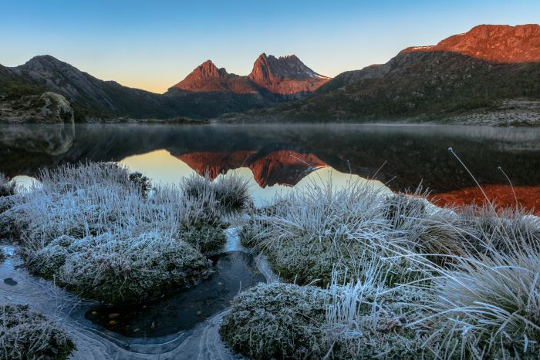
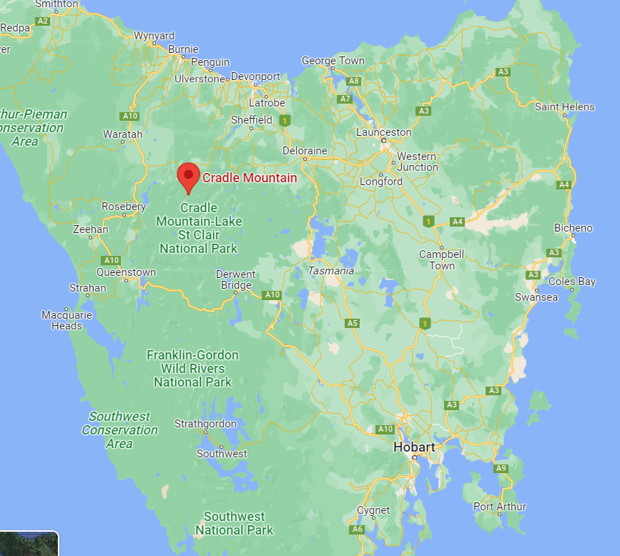
Other things you might stumble upon
Cradle Mountain / Lake St Clair National Park
Cradle Mountain and its surroundings is a hugely popular destination for both tourists and locals alike. It is a symbol of Tasmania’s pristine
Wilderness.
The famous Overland Track is a 65km, 6 day bushwalk that is very challenging trek!

Slide 12
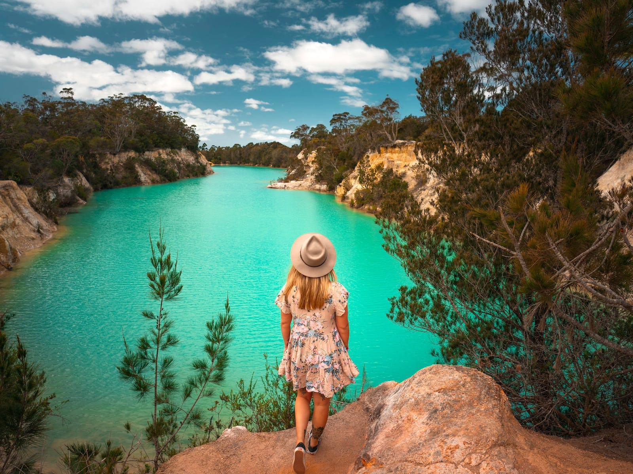
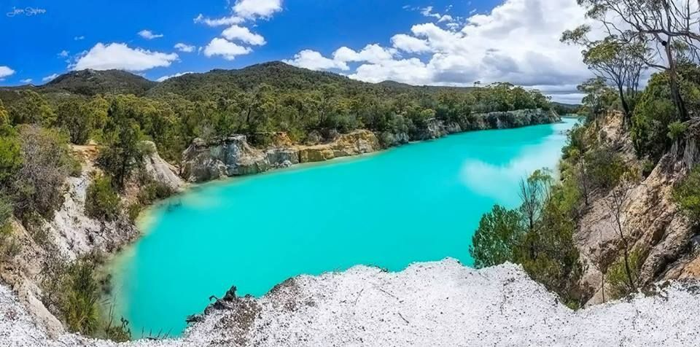
Other things you might stumble upon
Little Blue Lake
An old pit mine in the northwest of the state that over time has become reclaimed by nature.
Its bright aqua blue colour is due to the high level of minerals in the nearby earth in the water.

Slide 13
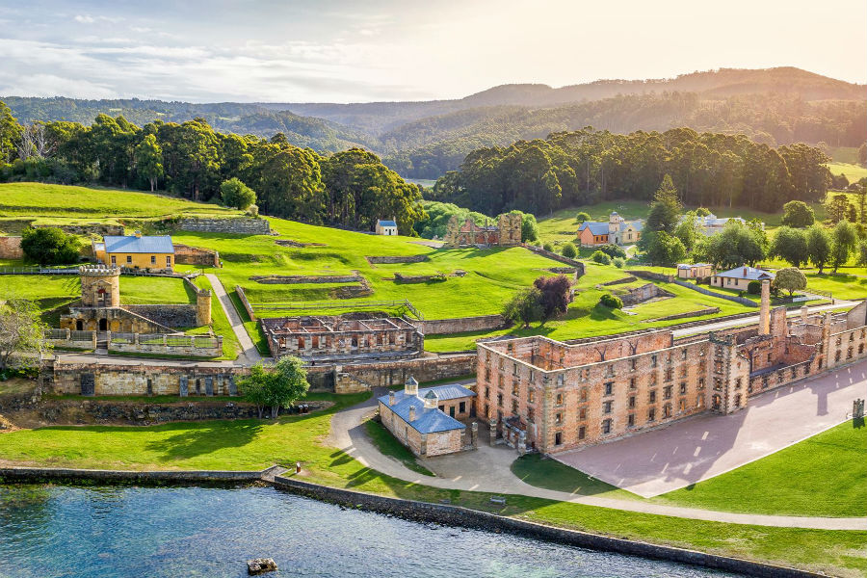
Other things you might stumble upon
Port Arthur
Between 1830 and the 1850s, Port Arthur was a large convict settlement. Criminals were sent from Great Britain to Australia, sometimes for only stealing a loaf of bread, to begin their sentence. Most engaged in work like ship-building and harvesting timber until their release.
That is, if they lived that long. Conditions were notoriously harsh and convicts were treated very poorly.
The collection of old buildings here remain a popular spot to visit!

Slide 14
I hope you have learnt something interesting from my presentation
And I look forward to hearing from
You soon! ☺

