Slide 1
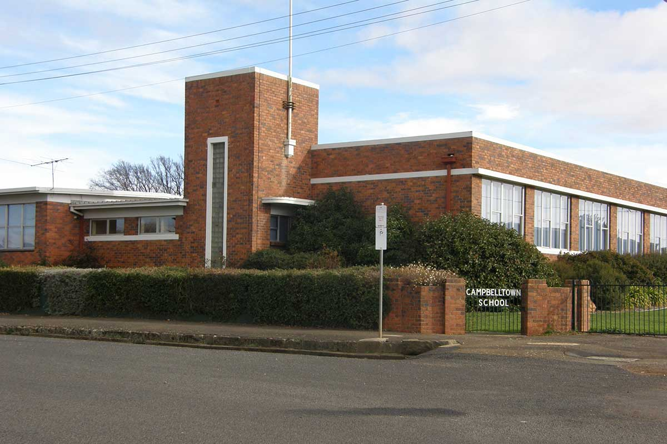
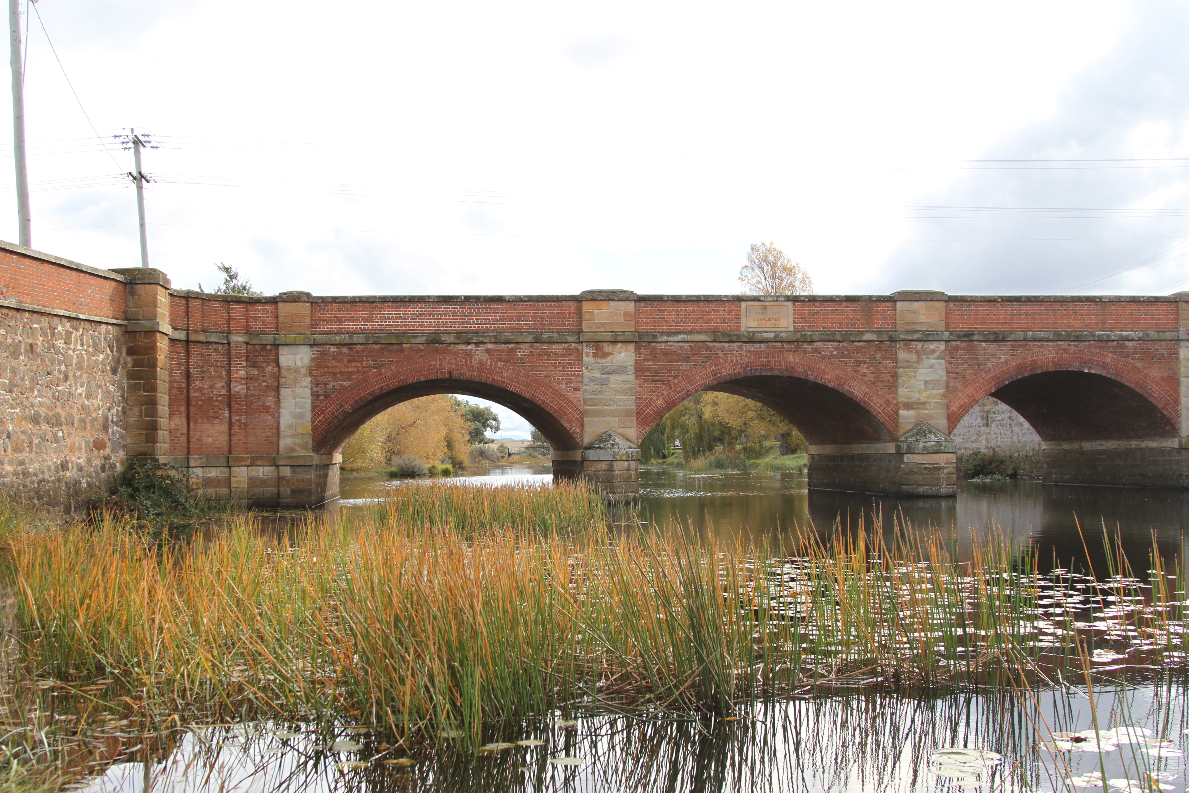
Campbell Town District High School
A sneak peak at the corner of the world

Slide 2
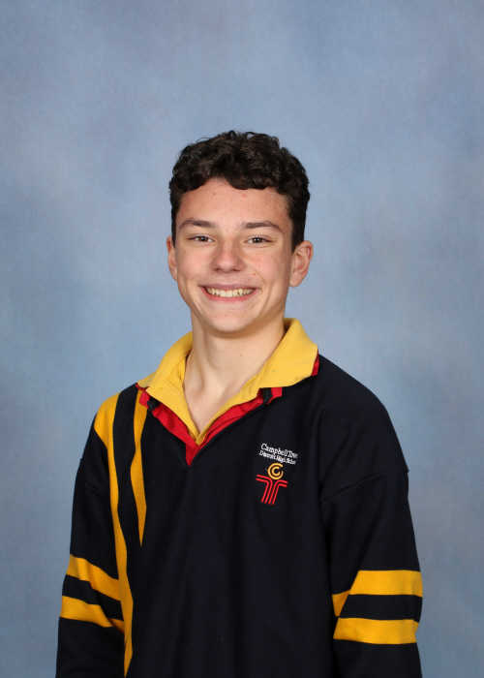
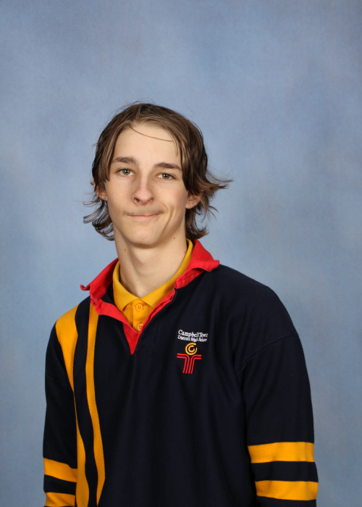
MÉ JMÉNO JE
MÉ JMÉNO JE
Liam
I’m Liam, I’m new to Tasmania and have been living here for more than half a year. I like video games and target shooting.
GRADE 10
Ty
I’m Ty, I’m a descendant Aboriginal of Tasmania. I like chicken and I’m sporty.
GRADE 10

Slide 3
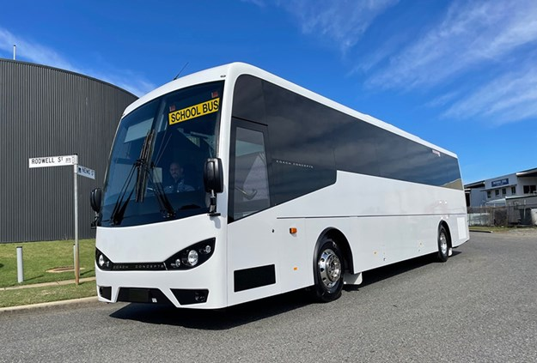
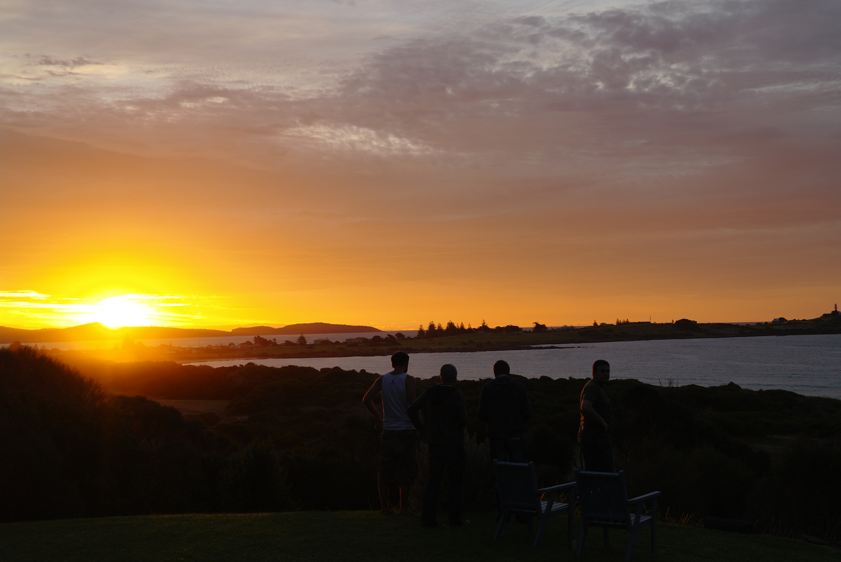
Our School Routine
We wake up at around 6:00AM to 6:30AM to get ready for school before our bus arrives.
Our bus arrives in our local suburb at around 8:20-ish as we get driven to school by public transport hired by our school. Actual school starts at 9:00AM.

Slide 4
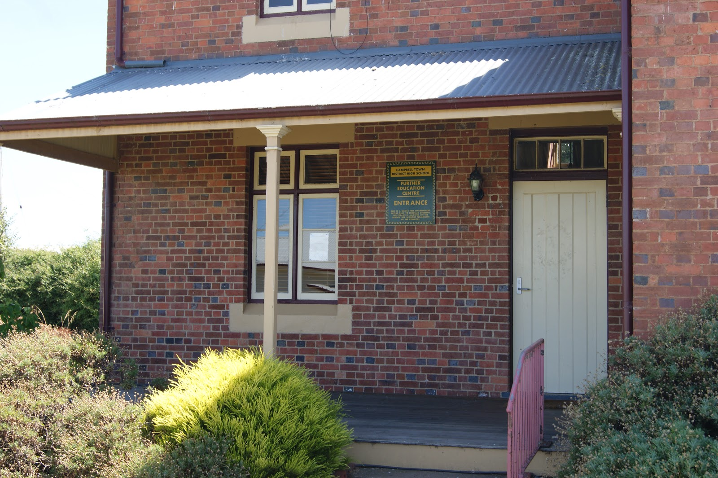
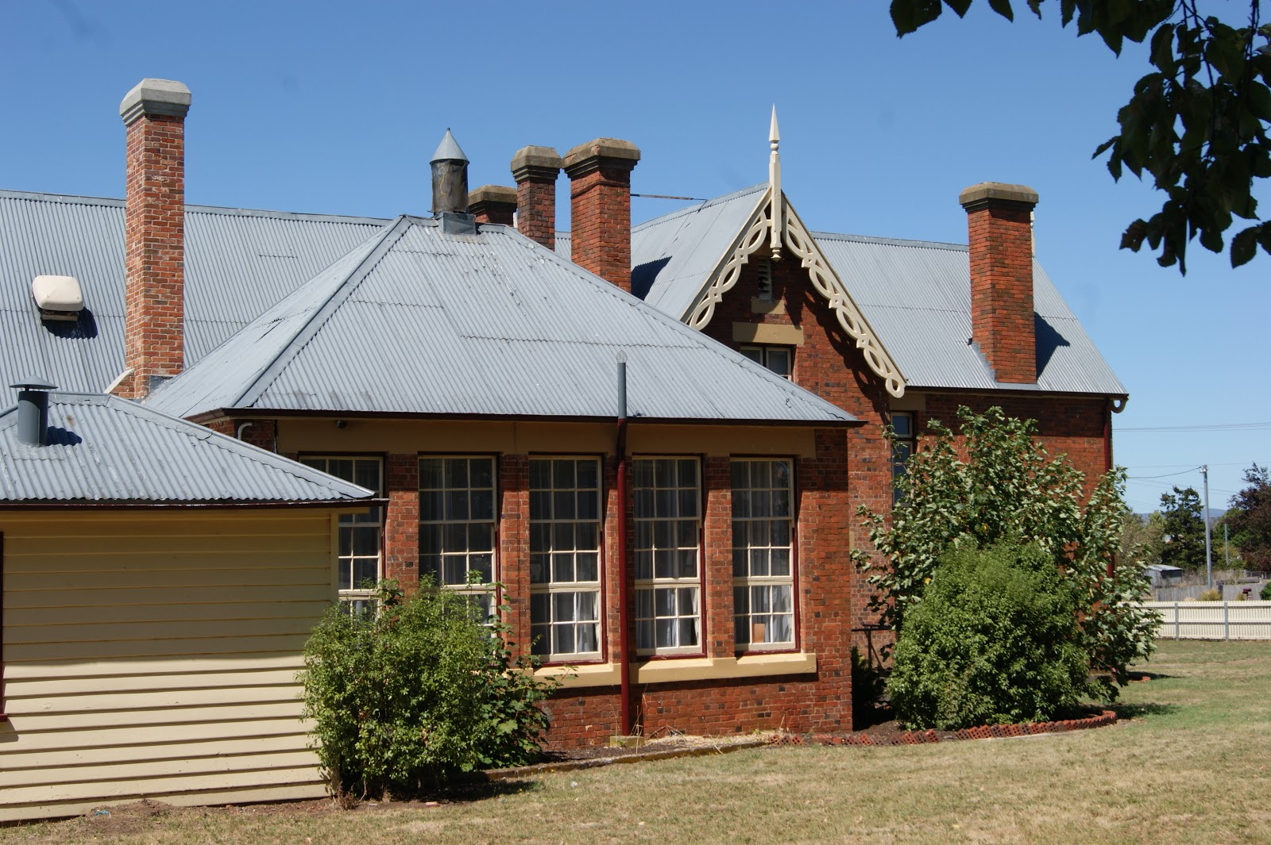
Our day has three blocks, each going for under two hours. We get two breaks in between these blocks, Recess and Lunch, each going for 20 minutes.
It’s very boring to have an hour and forty minutes of straight schoolwork.
That’s a total of 6 school hours.

Slide 5
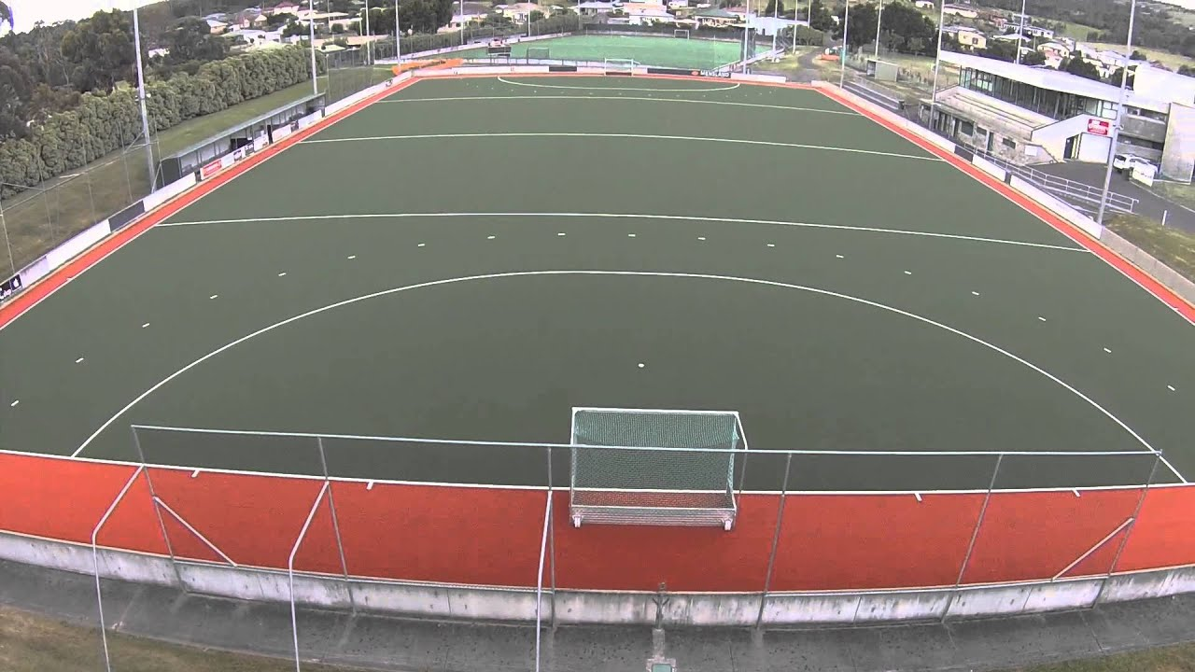
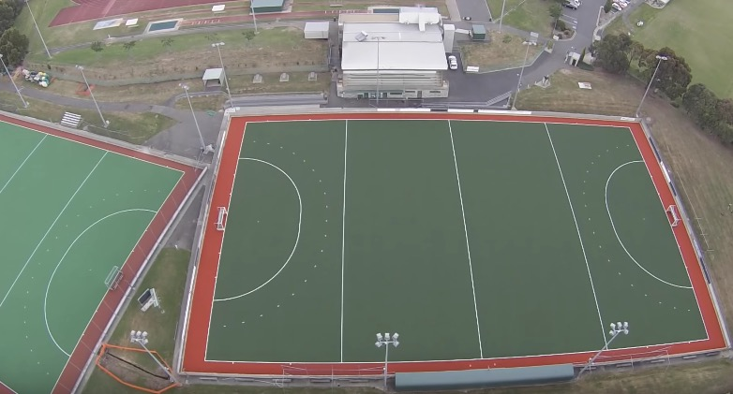
On Wednesdays we have sport. We picked Hockey, with the other option being Netball. On some days we have elective classes. We have a small variety of options to choose from.
But not enough electives to choose from (we have around 5)

Slide 7
Our Questions to a Czech School
Do you have a similar sense of humour? | What kinds of people are in your school? Is it diverse? | I like sports shooting, is it hard to get into in the Czech Republic?
What’s the climate of your area like? | Do you meet tourists often?

Slide 8
Ahoj!

