Slide 1
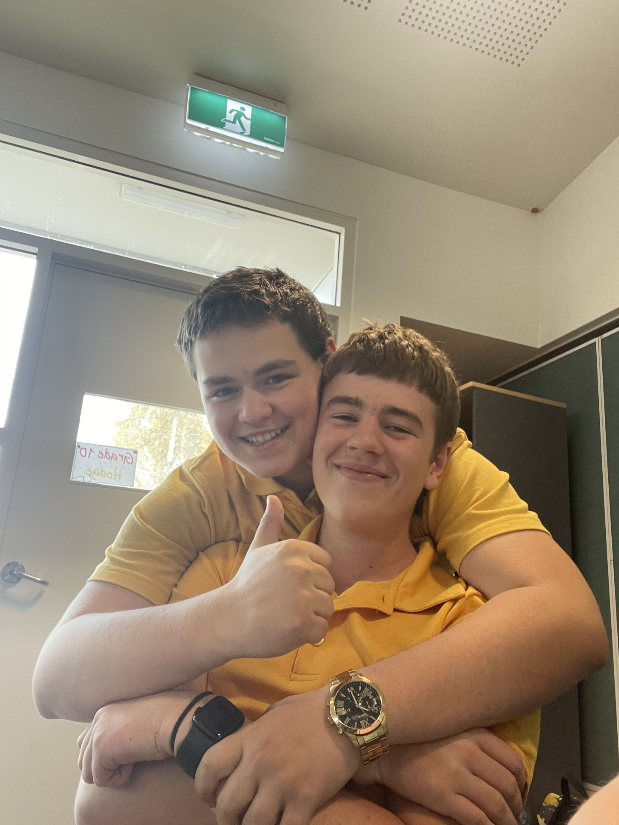
Hanna, Gemma, Ollie and Brodie
Presenter Name

Slide 2
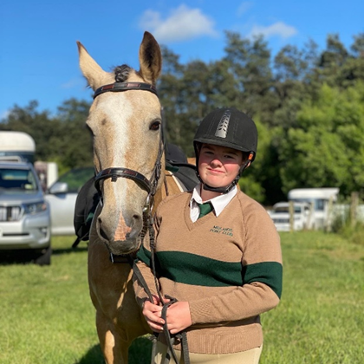
Hanna bailey
In the morning I wake up and go and feed my horses than get ready and then go to school with my little brothers and my mum.
I ride for midlands pony club with my best friend, which is once a month where most members come and ride horses for a day.

Slide 3
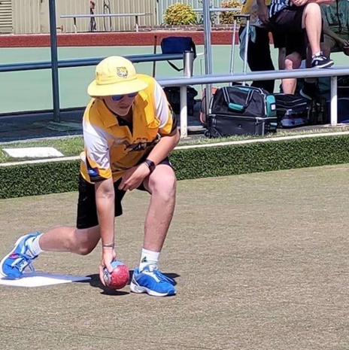
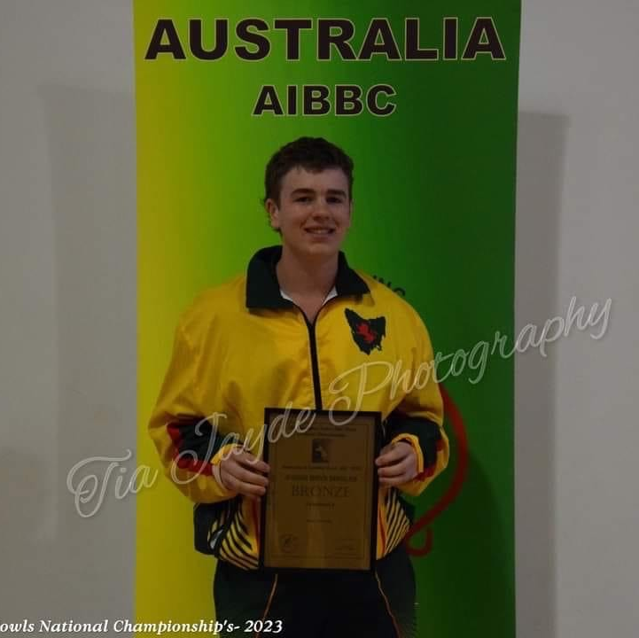
Ollie morrison
I live in Campbell town and not far away from the school and I can walk to school everyday.
I play lawn bowls for my state Tasmania and have some decent achievements holding 3 Australian under18 medals and 1 Tasmanian men's one.

Slide 4
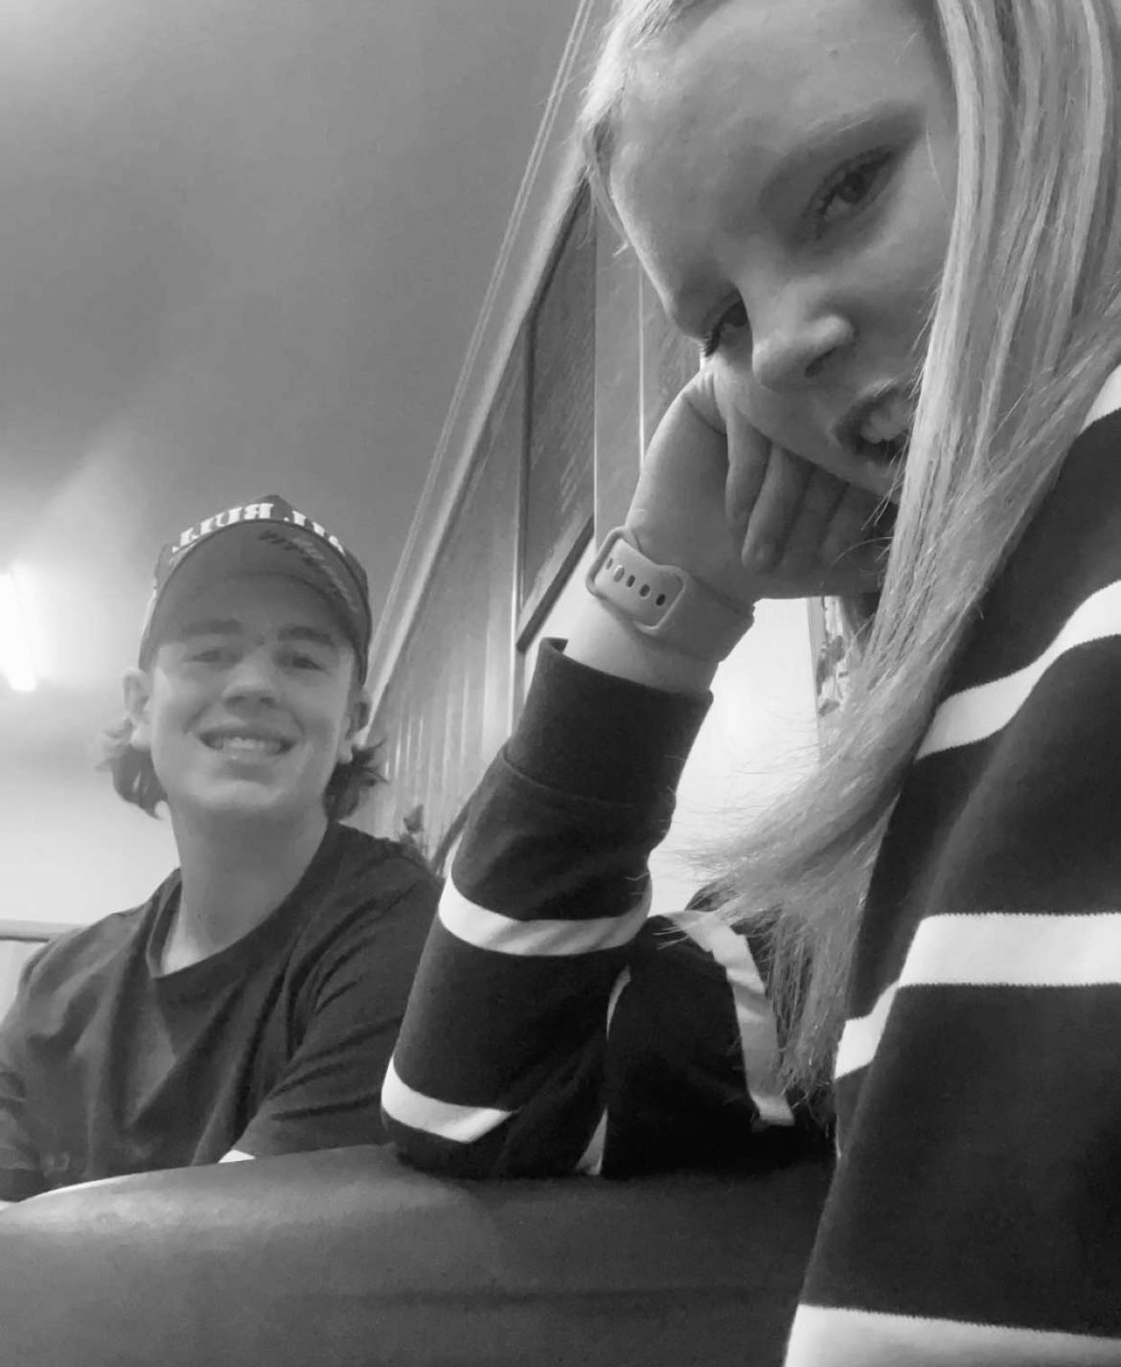
Gemma Fenton
In the morning and afternoon I catch the bus to school, the bus ride takes around 20 minutes from where I live.
I have grown up riding horses, playing cricket and hockey. I now participate in pony club once a month with my best friend Hanna.

Slide 5
Brodie Jackman
I live in Campbelltown close to school so I either walk or get dropped off of a morning.
I enjoy riding dirt bikes, spending quality time with my gorgeous girlfriend Marissa and being with my (adopted nephew) Ryder

Slide 6
5 questions for you
What type of sports do you play and how do you play them?
What time does your school day start and finish?
What's your national animal?
What age can you get a job?
What is national meal?

Slide 7
Horse riding in Tasmania
There are four zones, we ride in the northern zone of Tasmania.
Pony club has a range of activities including, show jumping, dressage, cross-country, games, polocrosse and flatwork.

