Slide 1
Our virtual exchange project
By Eden Back, Emily Harvey, & Belinda Holt

Slide 2
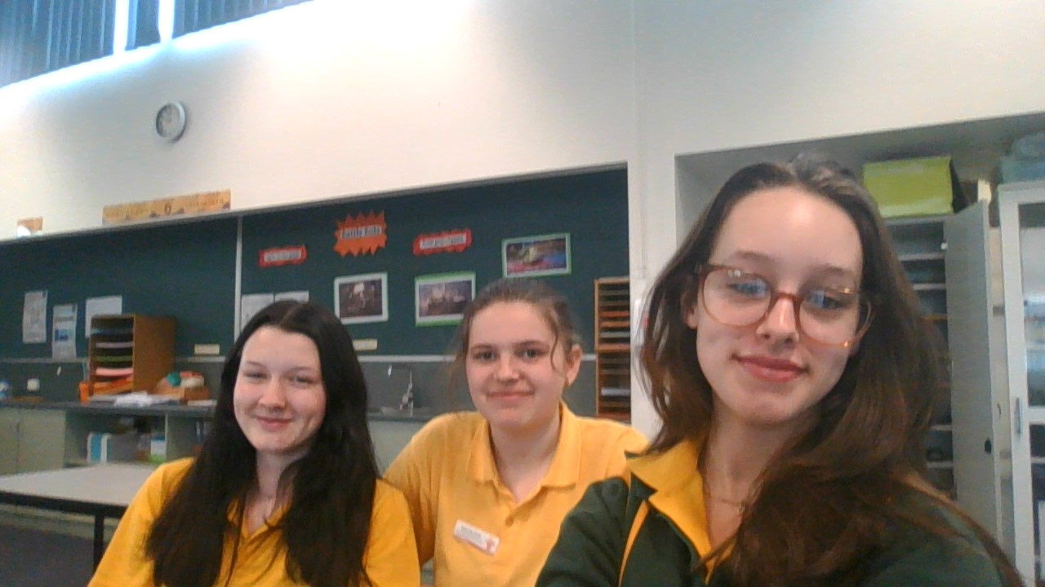
Who we are:
We’re three 15-year-old girls in grade nine at Campbell Town District High School. Naše jména jsou Eden Back, Emily Harvey, A Belinda Holt. Both of us minus Emily live in the same town of Ross, Tasmania and Emily lives in Tumbrighd Tunbridge so our morning are I little different but with this project we want to show you how we live our individual and jointed day to day school life.

Slide 3
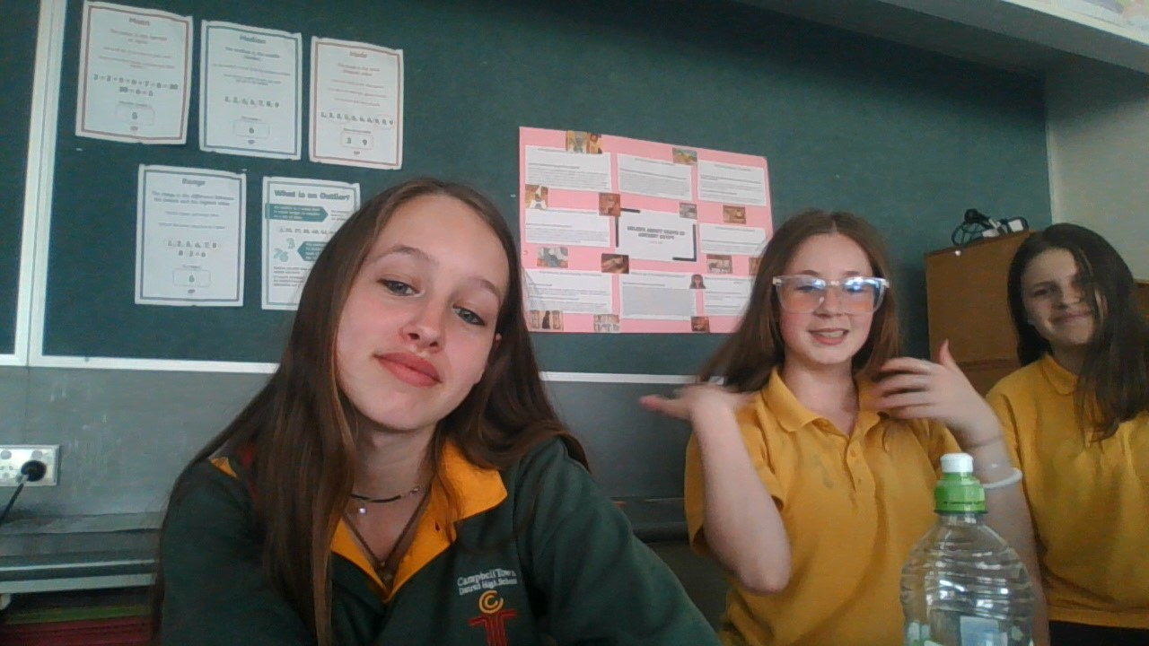
Introducing Eden Back
I'm a 15-year-old girl born on Anzac Day. I'm a brunette, taurus with medium length hair and green/blue eyes. I'm in grade nine at Campbell Town District High School. I like reading, listening to music by Taylor swift, Hozier, Chase Atlantic, The Weekend, & Selena Gomez. And I enjoy watching tv shows & movies like the ‘Chilling adventures of Sabrina’, ‘Killing eve’, ‘Pretty little liars’, ‘The grand Budapest hotel’, and ‘Gone girl’. I have twelve pets at home; a black and tan kelpie sheepdog, a black and white border collie sheepdog, their seven mixed pups, a sheep named Tilly, a black cat named Niko, and a grey hem named Henriette.

Slide 4
Eden’s Monday Mornings
Every school day I wake up at 7:00am from my loud alarm then I let four more alarms so off every five minuets until I get out of bed, have a shower, get ready for the school day, and help my mum with anything she needs. I have a little sister, Zara she's younger by two years and every morning I walk her up and wait for her to get ready. As she gets ready I'm usually already done so I make myself something to eat. Then I watch my favourite YouTubers and scroll on Pinterest. Zara and I leave for the bus at 8:08am every morning and arrive at school at around 8:30-40am waiting for school to start at 8:50am. While my friends and I wait I get my things out for the upcoming English lesson with Mrs Pullen and Maths lesson with Mrs barber. Before the bell goes off I head to my friends Harrie and Tahlia in the grade bellow me’s class room where we talk and hangout. We have four blocks and six class periods the first two finishes at 10:10am. After that we go outs) class also with Mrs Pullen after that we have another half hour break outside and then the last class of the day is my personal interest class ‘homemade harvest’. School ends at 3pm. Zara and I get off of the buss at 3:17pm we then walk home and take care of our pets. And over all I enjoy most of it.

Slide 5
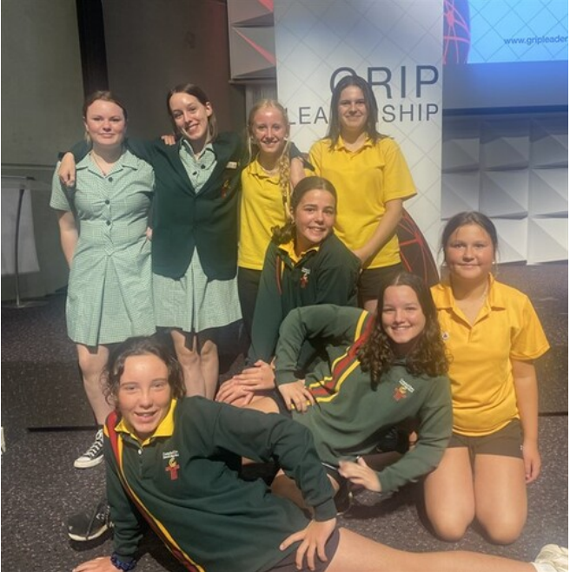
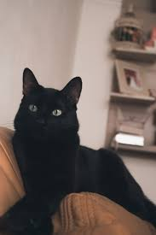
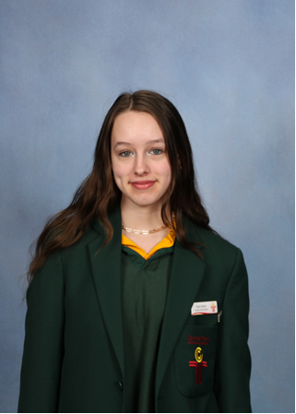
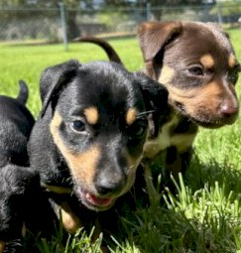
Eden's Pictures

Slide 6
Introducing Emily Harvey
I’m a short brunette with tons of energy I live in a small town called Tunbridge with my mum and stepdad we also home lots of different animals we are basically a little farm. My favourite colour is blue, and my favourite animals is a wombat I think there just the cutest. I love spending time with my friends, Eden, Belinda, Tahlia and Harrie, as well as my classmates. I love spending my weekends with my boyfriend Declan or my niece addi (6) and nephew Hunta (10) that’s where I truly shine with happiness, I love being an auntie maybe because I’m still a child by heart. In the future I really want to work in childcare mainly because I love kids and I get told all the time I’m really good with kids.

Slide 7
Emily's Monday Mornings
I wake up around 6-6:30, I let my dogs outside then I feed my 3 baby lambs I then get a jumper on because tassies cold 98% of the time, I then let my cats out and feed my chickens, ducks, rabbits and guinea pigs and depends on the day but ill feed my pet rats.
I then head inside and start getting ready for school, then leave the house at around 8 and get to school around 8:30 – 9 I then start into English then that goes into maths, we then go on our 30 min recess break where I hang with my friends who really make my Monday morning. So there you go that’s my Monday morning.

Slide 8
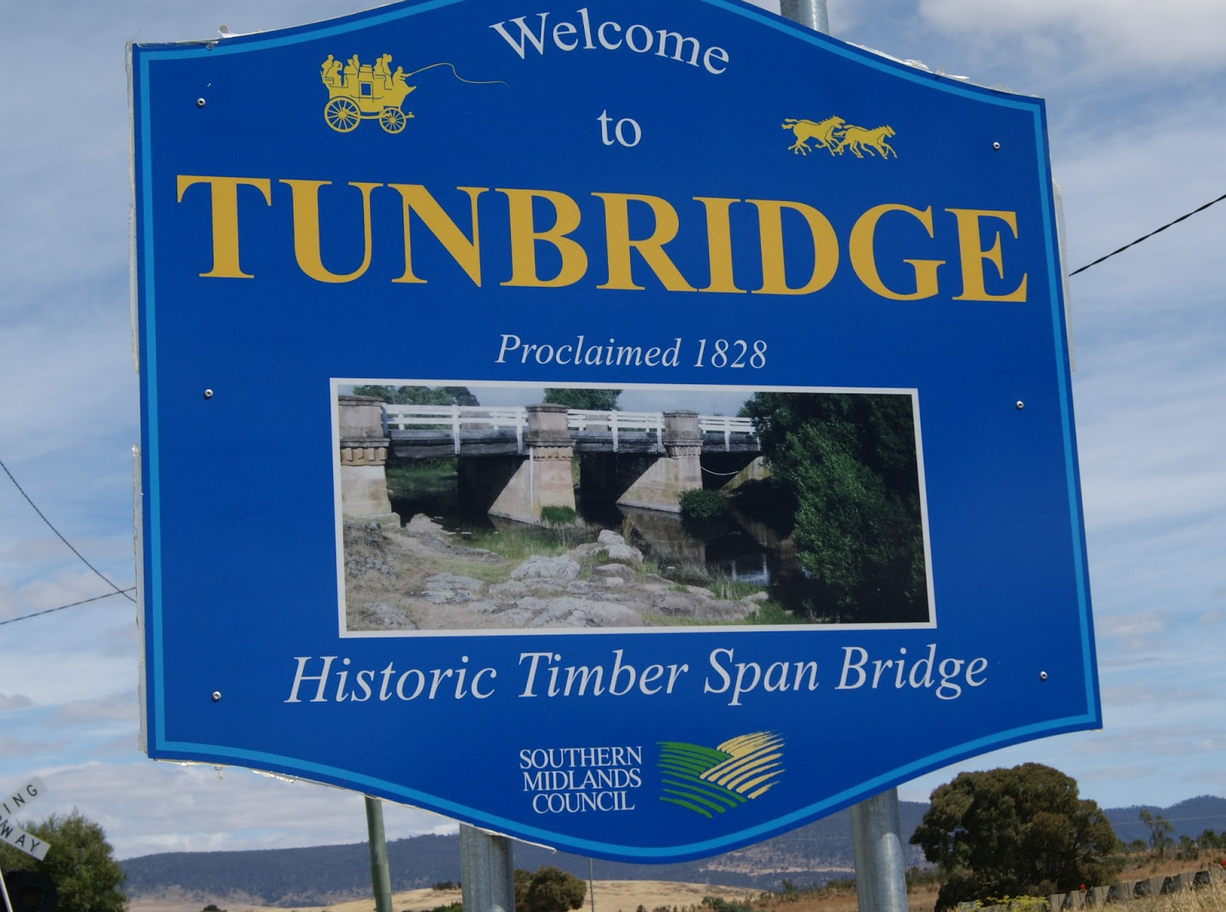
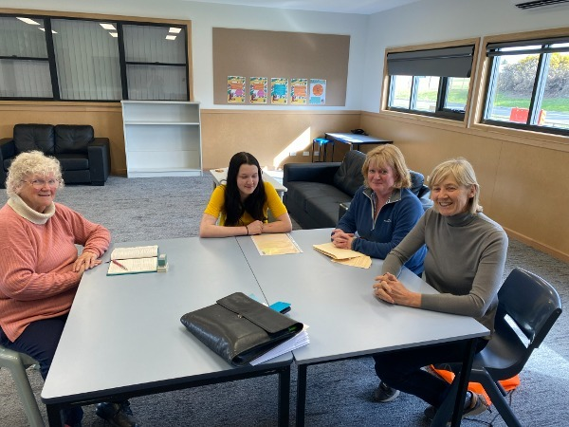
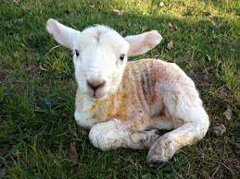
Emily's Pictures

Slide 9
Introducing Belinda Holt
I’m a 15-year-old girl in grade nine at Campbell Town District High School. I enjoy reading Fantasy, mystery, and horror books. One of my favourite hobbies is drawing and making origami stars that I collect in jars. I enjoy hanging out with my dad and helping him with gardening and fixing things around the house.

Slide 10
Belinda’s Monday Mornings
Every school day I wake up around 7:30am from my alarm. I get up out of bed and get dressed, then I feed my fish and have breakfast. I also pack my lunchbox in my bag that has been packed the night before. I then either sit and watch Tv for a bit or clean up my room and wait until it’s time to leave, 8:05am. Once it’s time to leave I say bye to my nan and then walk to the bus stop in ross which only takes a few minutes, I often listen to variety of songs on the way to kill time as I wait for the bus with many other people from my school. The bus then arrives around 8:20am and we all hop on, and it takes us to our school around 8:40am. When I get off the bus and walk to my classroom and set my bag down and check what we have first for the lesson, but before class starts (8:50am) I often hang out with my friends, Harrie, Eden, Tahlia, and Emily, and we sit and talk before the bell goes and we then leave to our classrooms to our arranged seats and start our lesson. When the lesson is over, me and my friends meet up and go to our favourite seat, the duck seat. We eat and talk until the bell goes again and we start our next lesson, and it repeats for twice until the day is finally over at around 3:00pm. I catch the same bus I did in the morning, and it takes me back home to ross where I walk back home. I change out of my school clothes and repack my lunch box for the next day, and then after that I often go outside into my dad’s shed and hang out with him for most of the day and help him with gardening. And that’s my Monday morning.

Slide 11
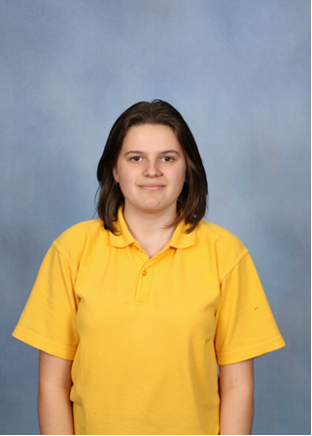
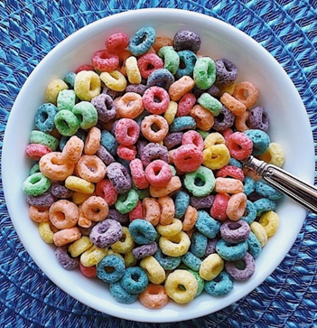
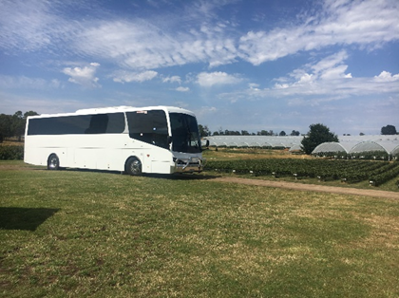
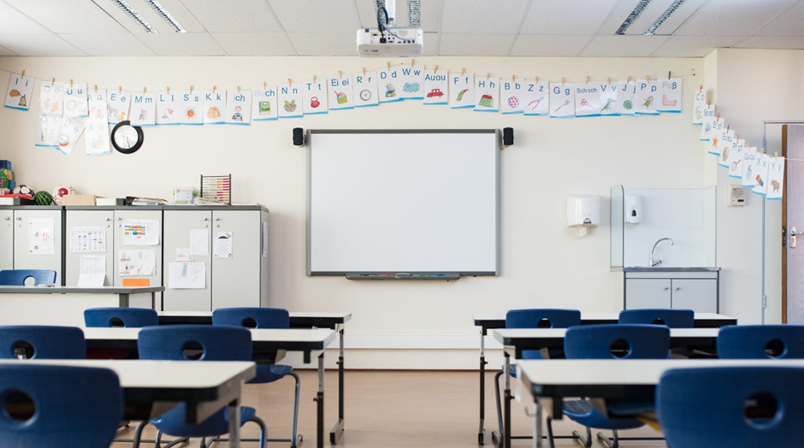
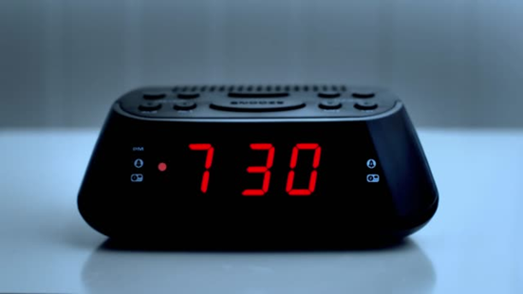
Belinda's Pictures

Slide 12
Five questions we would like to ask you:
What's your daily school/ life routine?- Eden's question
What's your most interesting tradition?- Eden’s question
If I went to the Czech Republic what five things should I do, get, or see - Eden’s question
What's your favroite country? - Belinda’s question
What's your favroite Czech food?- Emily’s question

