Slide 1
Exchange project
By Ash and Isaiah

Slide 2
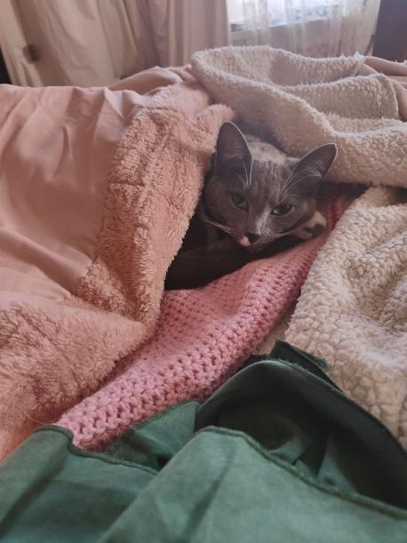
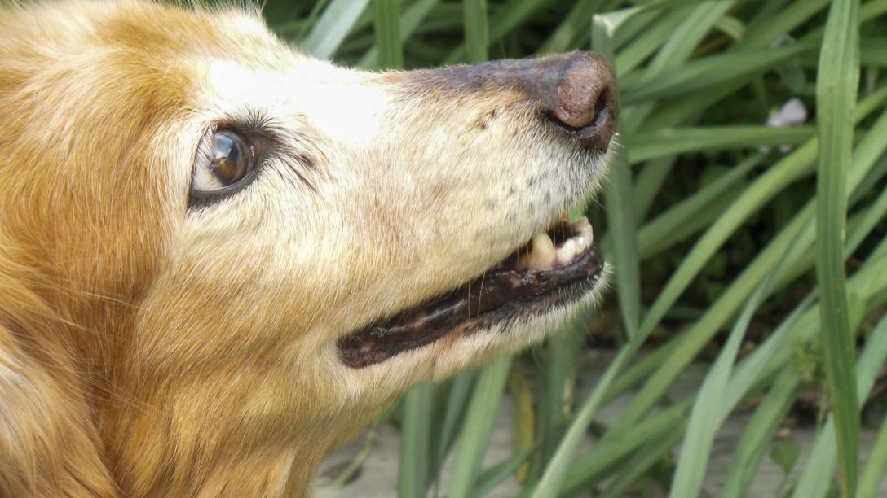
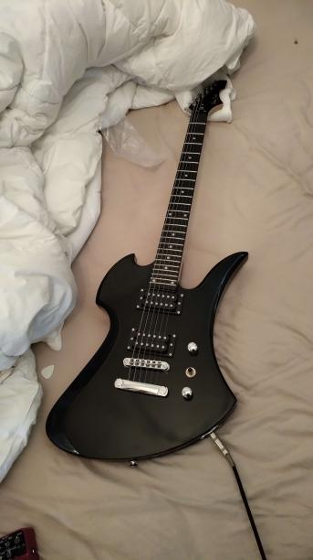
Hobbies and interests
Moje jméno je Asheron Watkin
I am in grade 9 and live in Avoca with my mum and Ross with my dad, I love playing guitar and bass along with an interest and experience in music production. My other interests lie in the humanities and art mainly gothic literature, history and left wing politics.
I adore horror films like “the thing”, “prince of darkness” and “evil dead” as well
I have two cats named Lucretia and Elise both still kittens.
along with a seventeen year old dog named Fizzgig
Moje jméno je Isaiah Catherall I am in grade 9 and live in Avoca, I like gaming, listening to music and hanging out with friends and family.
I have 2 dogs their names are Honey and Abby, along with having 2 Cats their names are Pearl and Waffles
Fizzgig
Guitar
Honey
Waffles

Slide 3
School Routine
Ash
I wake up usually at some time between 6:30 and 7:00, I then have breakfast, shower and other morning routine such brushing teeth that stay the same around the world. after this if there is time left before the bus arrives I practice guitar, usually at around 7:47-7:50 I leave for the bus stop, this is the time where other students will congregate waiting for the bus once on the bus students will find a seat and sit in for the 25-30 minute ride. Then students will have to wait for homegroup for school to start during this period students will intermingle and chat with each other after this homegroup will start. After homegroup the first lesson will commence it depend on the day on what class it will be, after the first lesson it will be recess. Recess lasts 30 minutes after the 30 minute the second period will start it again will depend on the day, lunch is 30 mins long the same as recess the third lesson is the last and is generally more laid back then the others, the bell goes at 3:00 the students will leave towards the buses and go home.
Isaiah
I wake up at around 6:45, I then go have a shower, at around 6:50 – 7:00 I get dressed, around 7:10 I have breakfast, after I eat breakfast I go and brush my teeth, then I sit around using my phone till about 7:48 where I start heading for the bus, we get on the bus at around 7:55 – 8:00. <--The rest is already explained since we go to the same school

Slide 4
Questions for students in Europe
What is the favourable guitar brands in the Czech Republic?
What form of music is most popular form of music?
Are their any interesting folk tales, urban legends or ghost stories?
Why does Prague have a such a large amount of gothic buildings?
How good are the music programs within Czech schools?
What is the school routine in the Czech Republic?

Slide 5
Tasmanian History
10,000 years ago the first people arrived in Tasmanian over a land bridge from mainland Australia
In 1642 dutchman Abel Tasman form the Dutch East India Company sights Tasmania and names it Van Diemen’s Land after Governor-general Antony Van Diemen
After a multitude of other explore of ether French, British or Dutch survey the rivers the first European settlement is founded my the British crew of ships lady nelson and Albion at Risdon cove naming it Hobart, Hobart is now the capital and largest city in Tasmania the British then becomes the main colonizer
Tasmania had become the main colony to send convicts to. During this Tasmania had a boom in population and economy and henceforth enter a state of unrest stemming from the convicts outnumbering all others lead to a large amount of bushrangers (bushrangers are escaped convicts or outlaws avoid the law by hiding in the wilderness, they have a heavy influence on Australian folklore are generally portrayed anti-heroes similar to American westerns)
In the mid 1800s, Slowly the convicts became free after changing laws and this caused more of the colonizes to start farming which lead to them taking the land of Tasmanian Aboriginals this caused a increases in tension leading to raids on homesteads and farms, and in retaliation the colony of Van Diemen's land started a 30 year long genocide on the aboriginal peoples during this period the indigenous peoples suffer heavily with most languages whipped out and thousands dead.
Tasmania then joined the federation of Australia in 1899 Tasmanian, history after this then followed mostly the same path of Australia history albeit on a smaller scale, major after this include the black Tuesday bushfires in 1967, the proliferation of hydro and the formation of world first green party.

