Slide 1
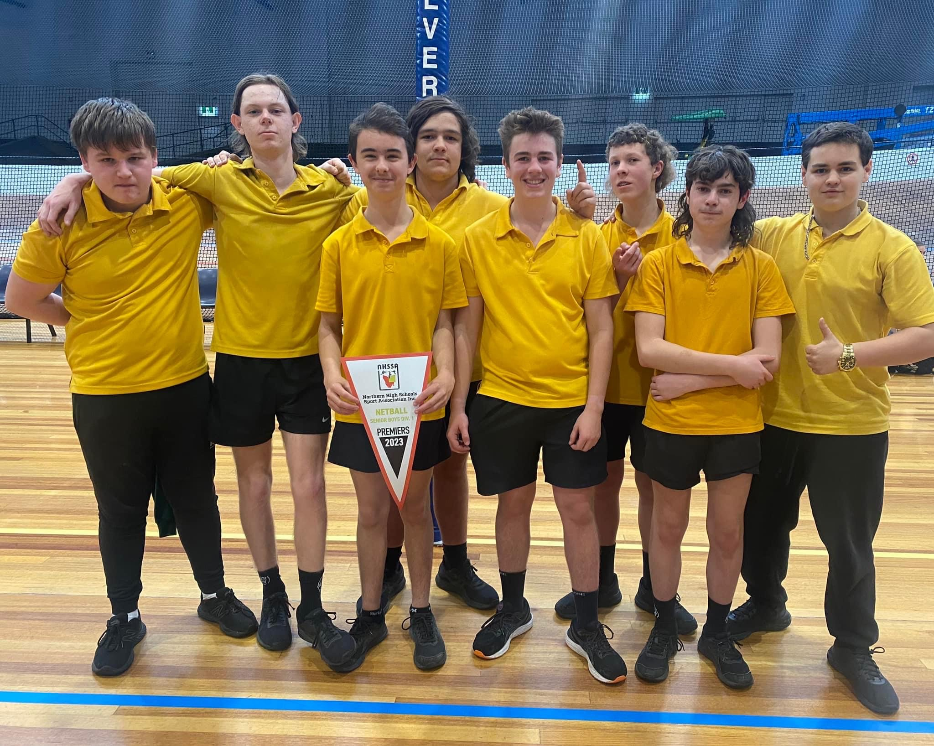
Hello our names are Jackson, Thomas, Brady, Aiden, Darcy and Ryan.
We have 5 questions for you.
What's fishing like over there?
What's the hunting like over there?
What's the most popular sport over there?
Do u know about the AFL (Australian Football League)
What is the best takeaway food?

Slide 2
Our school days are pretty similar but here's Jacksons
Jackson starts the day off waking up at 7:20am. He has a shower, feeds his dog, gets his lunch and then leaves at 7:40am to get onto the school bus. He arrives at school at around 8:25am. Our school days has 3 blocks and six periods we also have 2 30 minute breaks that cover 6 hours and 10 minutes. Then he takes the bus home and arrives at around 3:50pm
Thomas starts his day by waking up at 7:00am he has no breakfast, has a shower get ready for school then his dad take him to the bus stop at about 8:00am then heads to school on the bus.

Slide 3
What is the afl
AFL stands for Australian Football League and it is the most popular
sport in Australia.
There is 18 teams and with around 30 players listed but only 23 get selected.
There are around 800 current afl players
On the next page is a video explaining the rules
125.5 million people watched the afl throughout the 2022 season
The 2022 AFL grand final had 100,024 people attend, they average 100,000 every year.
There is also a women's league that has only just taken off in the last 5 to 8 years with them only just getting an AFLW team for every club.

Slide 4
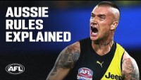

Slide 5
The afl is known for being a very hard contact sport that has completely no protection at all.

Slide 6


Slide 7
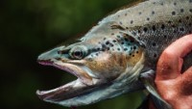
Trout fishing in Tasmania

Slide 8
What is the fishing like?
Fishing is good in Tasmania, it is known for fresh water fly fishing and lure fishing.
Some hot spots in Tasmania are Great Lake, Brumby’s Creek, Tooms Lake, Lake Leake, St Patricks River and Macquarie River.

Slide 9
Fishing questions
What fish do you catch?
Is it good fishing?
What's the main target species?
Do you get trout?

